Slide 1
Expanding ${\left(a+bx\right)}^{n}$ (4.2)

Slide 2
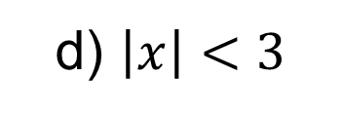
1
State the values of $\left|x\right|$ for which
the binomial expansion of
${\left(3+2x\right)}^{−4}$ is valid.
a) $\left|x\right|<1$
b) $\left|x\right|<\frac{2}{3}$
c) $\left|x\right|<\frac{3}{2}$
d) $\left|x\right|<3$

Slide 3
2
State the values of $\left|x\right|$ for which
the binomial expansion of
${\left(5+x\right)}^{−3}$ is valid.
a) $\left|x\right|<5$
b) $\left|x\right|<1$
c) $\left|x\right|<\frac{1}{5}$
d) $\left|x\right|<125$

Slide 4
State the values of $\left|x\right|$ for which
the binomial expansion of
${\left(2+3x\right)}^{−5}$ is valid.
3
a) $−\frac{3}{2}≤x≤\frac{3}{2}$
b) $2≤x≤3$
c) $−5<x<3$
d) $−\frac{2}{3}<x<\frac{2}{3}$

Slide 5
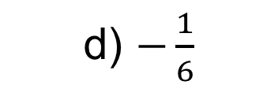
4
Given that $\left|x\right|<\frac{1}{3}$ in the expansion
of ${\left(3+ax\right)}^{−\frac{1}{2}}$, what is $a$?
a) $9$
b) $3$
c) $\frac{1}{3}$
d) $−\frac{1}{6}$

